Slide 1
Lecture 2 R,L&C Parameters

Slide 2
Contents
Resistance Parameter
Inductance Parameter
Capacitance Parameter
Numerical Examples
Lecture 2

Slide 3
Resistance Parameter
The opposition, which limits the amount of current produced by the applied voltage, is called resistance.
Conductors have very little resistance.
Insulators have a large amount of resistance.
The symbol for resistance is R and practical unit of resistance is the ohm (Ω).
The opposite of resistance is conductance .
The lower the resistance, the higher the conductance.
Its symbol is G, and the unit is the siemens (S)
G is the reciprocal of R.

Slide 4
Resistance Parameter
The resistance of an electrical conductor depends on four factors:
The length of the conductor
The cross-sectional area of the conductor
The type of material and
The temperature of the material
R, is directly proportional to length, l , of a conductor and is inversely proportional to cross-sectional area, a, of a conductor
R = ρ l/ a
resistivity of the material ρ is measured in Ω-m

Slide 5
Resistance Parameter
Types based on resistor composition:
Wire-Wound Resistors
Carbon-Composition Resistors
Film-Type Resistors
Surface-Mount Resistors
Thermistors

Slide 6
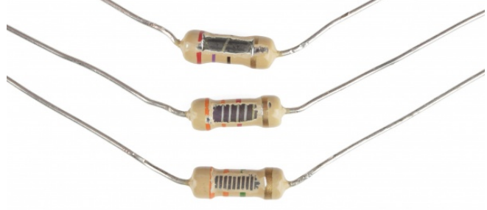
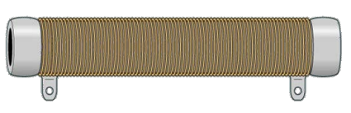
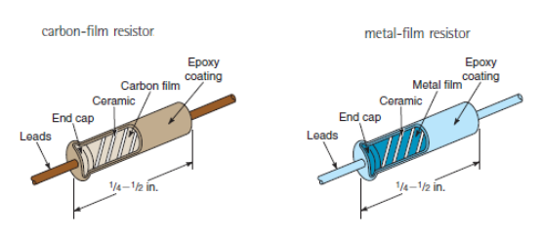
Wire-Wound Resistors
resistance wire is wrapped around an insulating core
Carbon-Composition Resistors
Made of finely divided carbon or graphite mixed with a powdered insulating material as a binder in the proportions needed for the desired R value.
Film -Type Resistors
depositing a thin layer of carbon on an insulated substrate and carbon film is then cut in the form of a spiral to form the resistive element.
In a metal-film resistor, a thin film of metal is sprayed onto a ceramic substrate and then cut in the form of a spiral

Slide 7
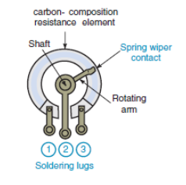
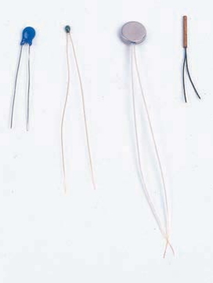
Variable Resistor
Wire-wound or carbon type
middle terminal is connected to the variable arm that contacts the resistor element by a metal spring wiper
As the shaft of the control is turned, the variable arm moves the wiper to make contact at different points on the resistor element
Thermistor
Thermistor is a thermally sensitive resistor whose resistance value changes with changes in operating temperature

Slide 8
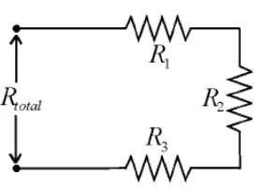
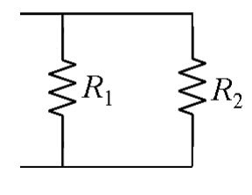
Resistance Parameter
Resistances in Series
Each resistance in a series circuit adds to the total resistance of the circuit.
Req = R₁+R₂+R₃
Resistances in Parallel
Each resistance in a parallel circuit reduces the total resistance of the circuit.
1/R_{eq} = 1/R₁+1/R₂
R_{eq} = R₁. R₂/(R₁+R₂)
Note : The formula for calculating the total inductance is of the same form as for calculating resistances

Slide 9
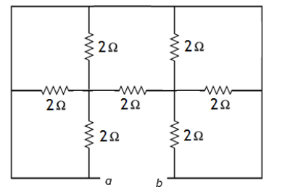
R Parameter : Numerical Example
Find the equivalent resistance between the terminals A and B?
Solution
R_{ab} =R_{eq} = 0Ω

Slide 10
R Parameter : Numerical Example
Which of the following statements is false?
a) The resistance of a short circuit is infinitely high.
b) The resistance of a short circuit is practically zero.
c) The resistance of an open circuit is infinitely high.
d) There is no current in an open circuit.
Solution(a) is False
The resistance of an short circuit is infinitely high.
The correct statement is : “the resistance of a short circuit is practically zero”

Slide 11
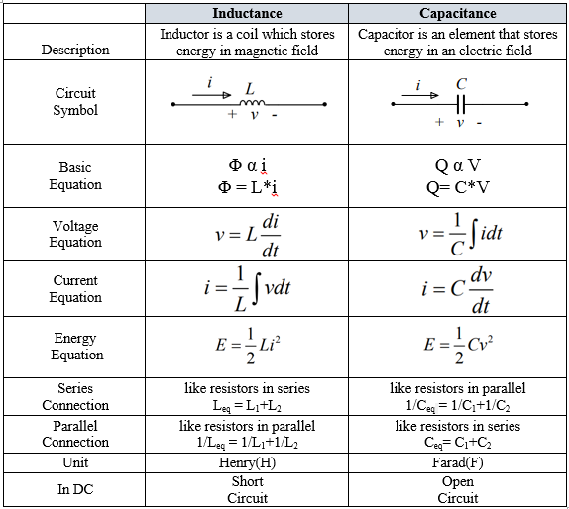
L&C Parameter : A Recap

Slide 12
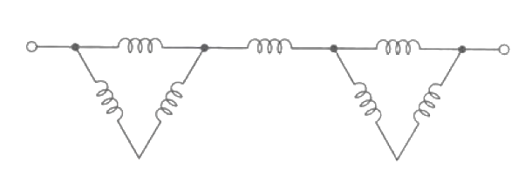
L Parameter : Numerical Example
If all inductors are 77pH each, Find L_{eq}
Answer
L_{eq} = ((77+77)||77)+77+ ((77+77) ||77)
L_{eq} = 179.6 pH

Slide 13
L Parameter : Numerical Example
Calculate the voltage across a 20nH inductor if the constant current into the + reference terminal is 5mA .
Answer
V_{L} = L dI_{L}/dt
Since DC current remains constant, dI_{L}/dt =0
Thus V_{L} =0 V

Slide 14
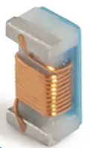
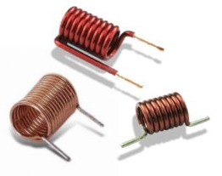
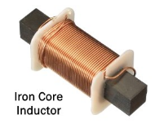
Inductor Types
Inductors can be classified according to their core material.
Air Core Inductor
Has no magnetic core
Iron Core Inductor
Ferromagnetic material is used as the core material.
Ceramic Core Inductor
Ceramic is a non magnetic material like air

Slide 15
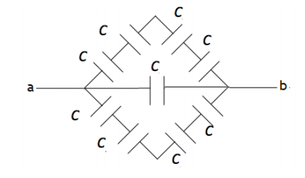
C Parameter : Numerical Example
If all capacitors are 10uF each, Find C equivalent.
Answer
s : series
Ceq = (CsCsCsC)+C+(CsCsCsC) = C/4+C+C/4=3C/2
Ceq = 3*10/2=15uF

Slide 16
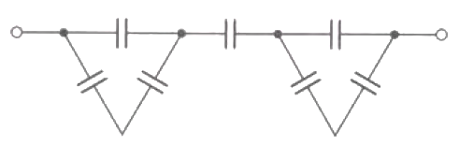
C Parameter : Numerical Example
If all capacitors are 10uF each, Find C equivalent.
Answer
s : series
C_{eq} = ((10s10)+10)s((10s10)+10)
C_{eq} = 4.286uF

Slide 17
C Parameter : Numerical Example
Q. Six capacitors of capacitances C1, C2, C3, C4, C5 and C6 are connected in series. C1> C2> C3> C4> C5> C6. What is the total capacitance almost equal to :
(a) C1 (b) C3 (c)C4 (d)C6
Answer
(d) C6
In series connection, Ceq will be close to the smallest capacitance.
In parallel connection, Ceq will be close to the highest capacitance.

Slide 18
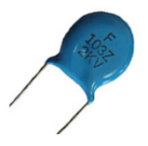
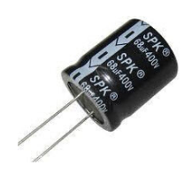
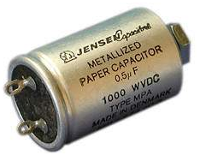
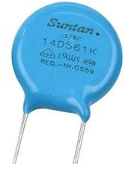
Capacitor- Types
Capacitors can be classified according to their dielectric material.
Ceramic
Capacitor
Aluminium Electrolytic
Capacitor
Paper
Capacitor
Mica
Capacitor

Slide 19
C Parameter : Numerical Example
Calculate the current flowing through a 20uF capacitor if the voltage across its terminal is 5V DC.
Answer
I_{c} = C dV_{c}/dt
Since DC voltage remains constant, dV_{c}/dt =0
Thus I_{c} =0 A

Slide 20
C Parameter : Numerical Example
A capacitor of 10uF is charged to 2000V. Find the energy stored in the capacitor
Answer
E = ½ CV²
E= 0.5*10u*2000²=20Wh

Slide 21
References
[1] Edward Hughes. “Electrical and Electronic Technology”, 10th Edition, Pearson Education Asia, 2011.
[2] William H. Hayt Jr. ,Jack E Kemmerly, Steven M Durbin, “Engineering Circuit Analysis”, 6th Editions, Tata McGraw Hill Publishing Company
[3] Vincent Del Toro, ‘Electrical Engineering Fundamentals’, Second Edition, Prentice Hall of India Private Limited, 2003

Slide 22
Thank You

